Slide 1


FYP
Recruit Right: Precision Hiring with AI Insight
Muhammad Naeemuddin
Muhammad Abdullah
Muhammad Raza
Dr. Umer Farooq
Department of Computing, FEST
Hamdard University

Slide 2
Table of Content
Problem Statement
Objective
FYP Scope
Our methodology
Our Project Plan (Time lines)
Budget / Costing (if any)
FYP Deliverables
Literature Review
Demo of 100% of Work
Experimental Evaluations & Results
Test Plan & Test Cases
References

Slide 3
Problem Statement
“Inefficiencies in Manual Technical Hiring Processes Hindering Growth”
• Extended time to fill positions • Cumbersome interview scheduling • Uneven evaluation criteria • High candidate churn • Rising recruitment costs
Notes:
“Today’s challenge for our logistics client is that every step of their technical hiring—from posting the role to making an offer—is done by hand. As a result, roles stay open for far too long, co-ordinating multiple interviews becomes a scheduling headache, and different interviewers use different criteria—so it’s hard to compare candidates fairly. All of this drives turnover up and costs up. Our goal is to automate and standardize these steps so they can hire faster, more consistently, and more cost-effectively.”

Slide 4
Objective
Automate Technical Interviews
Leverage Pre-Vetted Experts
Ensure Consistent Evaluation
Scale to Any Organization
Deliver Actionable Insights
Enhance Candidate Experience
Accelerate Time-to-Hire
Notes:
Automate Technical Interviews “By taking over scheduling, proctoring, and scoring of coding and system-design interviews, we free our internal team to focus on cultural fit and final selection.”
Leverage Pre-Vetted Experts “We maintain a roster of qualified technical professionals—across languages, frameworks, and domains—so every candidate meets with an interviewer who understands the role’s requirements.”
Ensure Consistent Evaluation “Our uniform question bank and scoring templates guarantee that every candidate is measured against the same criteria, making comparisons objective and transparent.”
Scale to Any Organization “Whether you’re a 10-person startup or a multinational enterprise, our on-demand packages let you add interview capacity instantly—no lengthy vendor contracts required.”
Deliver Actionable Insights “After each interview, you receive a concise report highlighting strengths, areas for improvement, and recommended next steps—so hiring managers can make data-backed decisions.”
Enhance Candidate Experience “Clear scheduling notifications, an intuitive platform, and real-time feedback keep candidates engaged and informed—boosting your employer brand.”
Accelerate Time-to-Hire “With automated workflows and expert availability, you can cut average hiring cycles by weeks, securing top talent before competitors do.”

Slide 5
FYP Scope
In Scope
Interview Plan Customization Collaborate with expert solutions engineers to design role-specific interview blueprints.
Expert Interviewer Network Leverage our roster of vetted Interview Engineers to conduct technical assessments.
Structured Assessment Workflow Build the UI and backend to run reliable, standardized evaluations—then advance top performers to the offer stage.
Out of Scope
End-to-end onboarding or offer-letter generation
HRIS/payroll integrations
Non-technical assessments (e.g., soft-skills tests, psychometric tools)
Long-term interview analytics beyond initial feedback reports
Notes:
“For clarity and feasibility, Recruit Right will focus on the core technical interviewing flow—namely, plan setup, expert-led assessments, and decision handoff. We deliberately exclude downstream HR processes like onboarding or integrating with payroll, as well as non-technical evaluations. This keeps our MVP tightly scoped around delivering a seamless, high-quality technical interview experience.”

Slide 6
Our Methodology
Discovery & Planning • Map pain points with stakeholders • Define user roles and system requirements
Design & Prototype • Draft wireframes for recruiter & candidate dashboards • Validate prototypes with pilot users
Development & Onboarding • Build scheduling, question-bank, and scoring engines • Vet and roster Interview Engineers
Test, Deploy & Iterate • Conduct QA and pilot tests • Roll out in phases and refine based on feedback
Notes:
“We begin by capturing requirements and defining the end-to-end flow. Next, we design and prototype the key interfaces, validating them with early users. Then we develop the core platform—scheduling, question management, scoring—and onboard our expert panel. Finally, we rigorously test, deploy in stages, and iterate using real-world feedback to ensure a polished, scalable solution.”

Slide 7
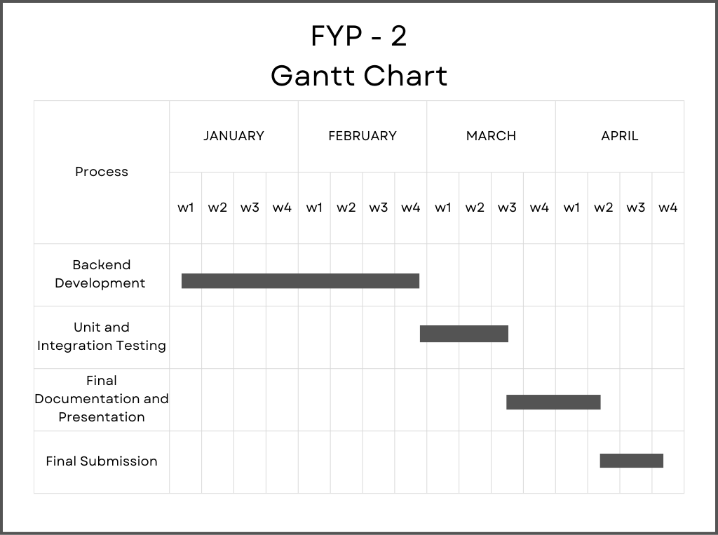
Our Project Plan

Slide 8
Budget / Costing
Prototype Phase Costs
Development Tools & Subscriptions
ChatGPT API / ChatGPT Plus: $80 USD/month (covered personally; no project expense)
Domain & Hosting (dev environment): $0 (using free tiers)
Hardware
Laptops & Workstations: Already owned (no incremental cost)
Miscellaneous
Software licenses (e.g., Figma, Postman): Covered via student/free plans
Total Project Expenditure to Date: Rs. 18,000
Notes:
“Because we built Recruit Right as a proof-of-concept, we leveraged existing hardware and free or personally covered software subscriptions. This slide underscores that the prototype required virtually no project budget beyond what we already had—highlighting the low overhead of our MVP approach.”

Slide 9
FYP Deliverables
Functional Recruit Right Prototype
SRS & SDS Documents
Complete Project Report (FYP-I & II)
Test Plan & Test Report
Project Poster & Demo Video
Supervisor Verification Certificate
GitHub Links for All Artifacts
Notes:
“Here are all the deliverables we’ve prepared for FYP-I and FYP-II. At the core is our working prototype of Recruit Right, supported by formal SRS and SDS documents. We’ve compiled a full project report that transitions smoothly from initial chapters in FYP-I to in-depth implementation and testing in FYP-II. A detailed test plan and accompanying test report document our QA process. In addition, we’ve produced a project poster and a concise demo video, and secured the supervisor verification certificate. Finally, every item is accessible via GitHub links, ensuring transparency and ease of review.”

Slide 10
Literature Review
[1] Internet Web page: Author. “karat”. https://karat.com/.
[2] Internet Web page: Author. “intervue.io”. https://www.intervue.io/.
[3] Mehboob, Muntaha & Ali, Saad & ul Islam, Saif & Ali, Syed. (2022). Evaluating Automatic CV Shortlisting Tool For Job Recruitment Based On Machine Learning Techniques. 1-4.10.1109/MAJICC56935.2022.9994112.
[4] G O, Narendra & S., Hashwanth. (2022). Named Entity Recognition based Resume Parser and Summarizer. 2581-9429. 10.48175/IJARSCT-3029

Slide 11
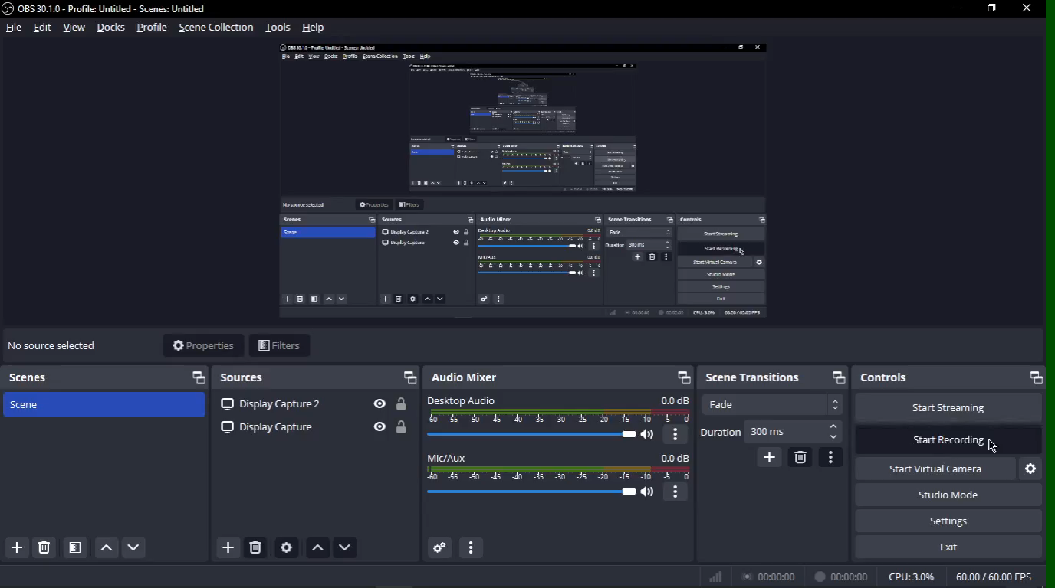
Demo of 100% of Work

Slide 12
Test Plan & Test Cases
Test Plan
The following table presents the detailed test plan, including the schedule for each functional component of the Recruit Right platform.
S.No | Description | Tested by | Start Date | End Date
1 | Login & Sign-Up | Naeem | 01-Jun-2025 | 01-Jun-2025
2 | Job Application Flow | Naeem | 02-Jun-2025 | 02-Jun-2025
3 | Status-Change Notification | Naeem | 03-Jun-2025 | 03-Jun-2025
4 | Interview Scheduling | Naeem | 04-Jun-2025 | 04-Jun-2025
5 | Interview Reminder Notification | Naeem | 05-Jun-2025 | 05-Jun-2025
6 | Interview “Start” Button | Naeem | 06-Jun-2025 | 06-Jun-2025
7 | Feedback Submission | Naeem | 07-Jun-2025 | 07-Jun-2025
8 | Security & Access Control | Naeem | 08-Jun-2025 | 08-Jun-2025
9 | Bulk Email Dispatch | Naeem | 09-Jun-2025 | 09-Jun-2025
10 | Logout & Session Termination | Naeem | 10-Jun-2025 | 10-Jun-2025

Slide 13
Reference
[1] M. Grinberg, Flask Web Development: Developing Web Applications with Python. 2014. [Online]. Available: https://dl.acm.org/citation.cfm?id=2621997
[2] L. Moroney, “The Firebase Realtime database,” in Apress eBooks, 2017, pp. 51–71. doi: 10.1007/978-1-4842-2943-9_3.
[3] “Git - reference.” https://git-scm.com/docs
[4] “GitHub.com help documentation,” GitHub Docs. https://docs.github.com/
[5] “GitHub Actions documentation - GitHub Docs,” GitHub Docs, Jul. 01, 2001. https://docs.github.com/en/actions
[6] “RFC 6749: The OAUTH 2.0 Authorization Framework,” IETF Datatracker. https://tools.ietf.org/html/rfc6749
[7] Auth, “JSON Web Token Introduction - JWt.io,” JSON Web Tokens - jwt.io, Nov. 30, 2024. https://jwt.io/introduction/
[8] “Making network requests with JavaScript - Learn web development | MDN,” MDN Web Docs, May 22, 2025. https://developer.mozilla.org/en-US/docs/Web/Guide/AJAX

Slide 14
Thank You!

